Slide 1
InTRO TO MODEL VIEW CONTROLLER
Or WTF is MVC?

Slide 2
MVC iS THE PRIMARY ARCHTECTURE PATTERN FOR ALL MODERN GUI INTERFACES

Slide 3
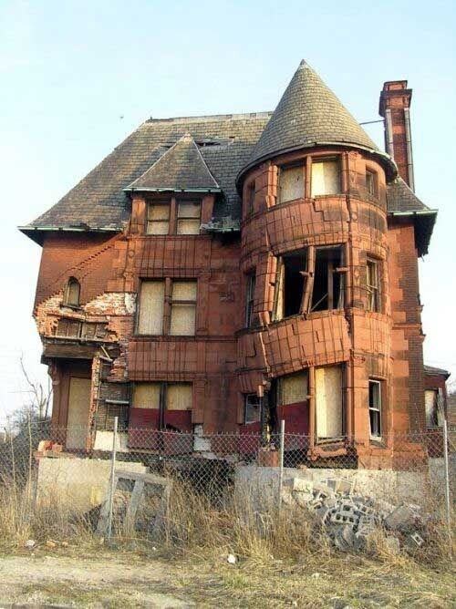
It Helps You NOT DO THIS…

Slide 4
MVC STANDS FOR MODEL VIEW CONTROLLER
YOU WILL SEE THIS TERM A LOT
THE IMPORTANT THING TO UNDERSTAND IS NOT MVC
BUT SEPERATED PRESENTATION

Slide 5
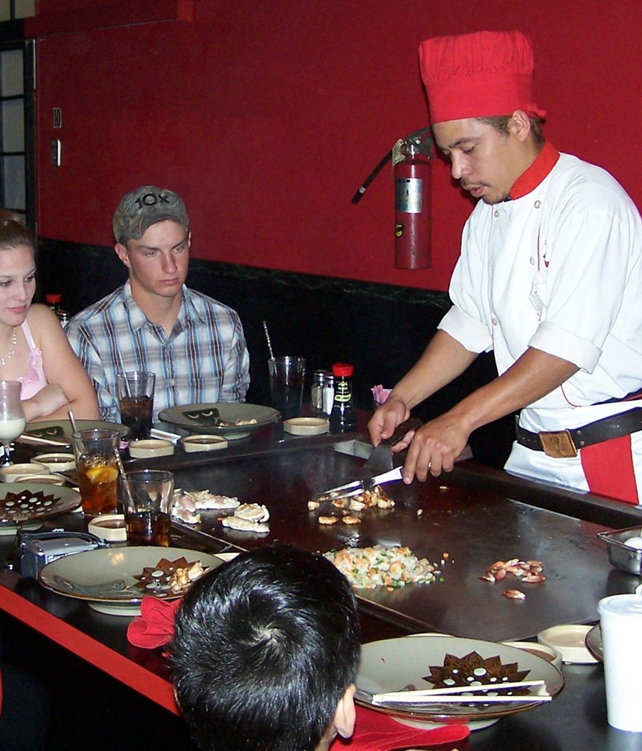
What IS SEPERATE PRESENTATION?
What you model
And how you present it
Are separate
Essentially, the opposite of this….

Slide 6
SEPERATE PRESENTATION IN A RESTAURANT
What a restaurant does: prepare food
How it present/delivers food: ?

Slide 7
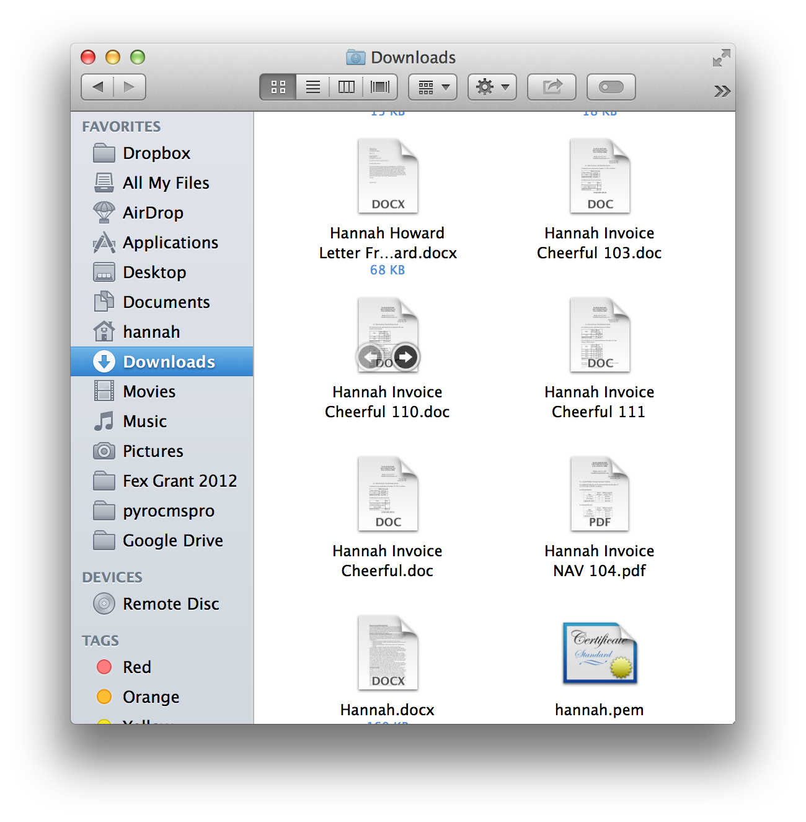
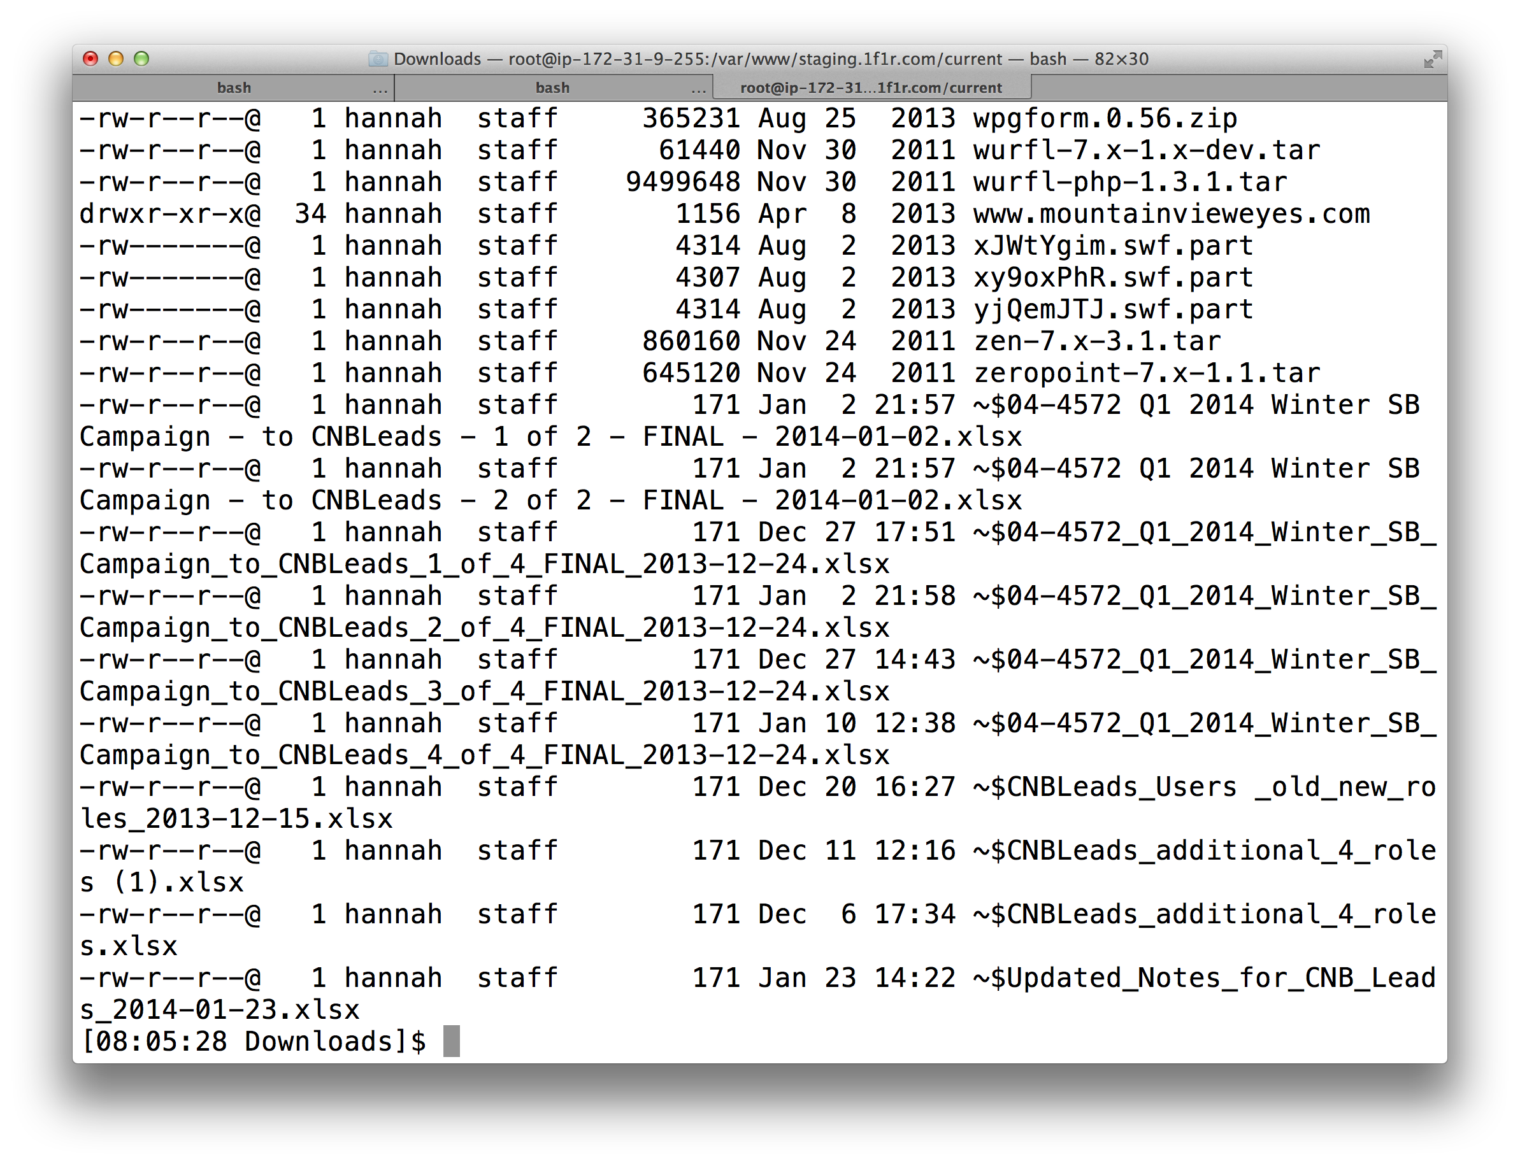
SEPERATE PRESENTATION ON A MAC
TWO WAYS TO VIEW THE FILE SYSTEM

Slide 8
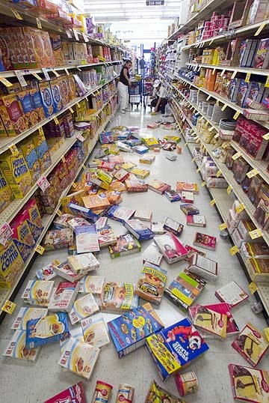
WITHOUT SEPERATE PRESENTATION:

Slide 9
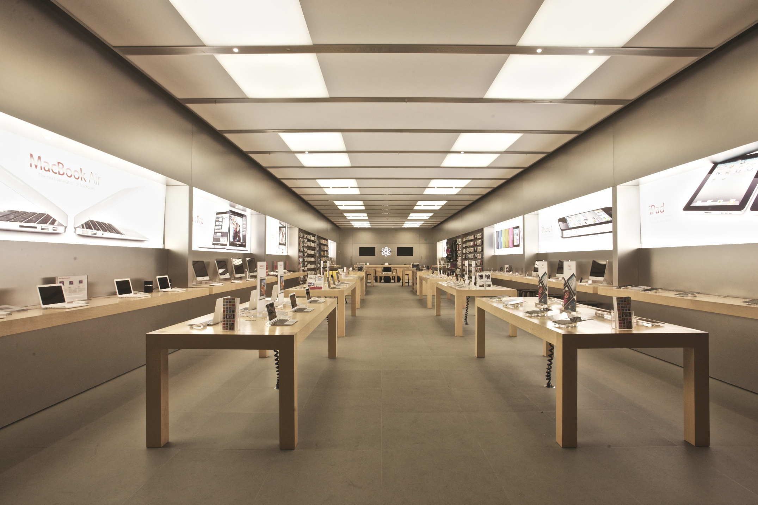
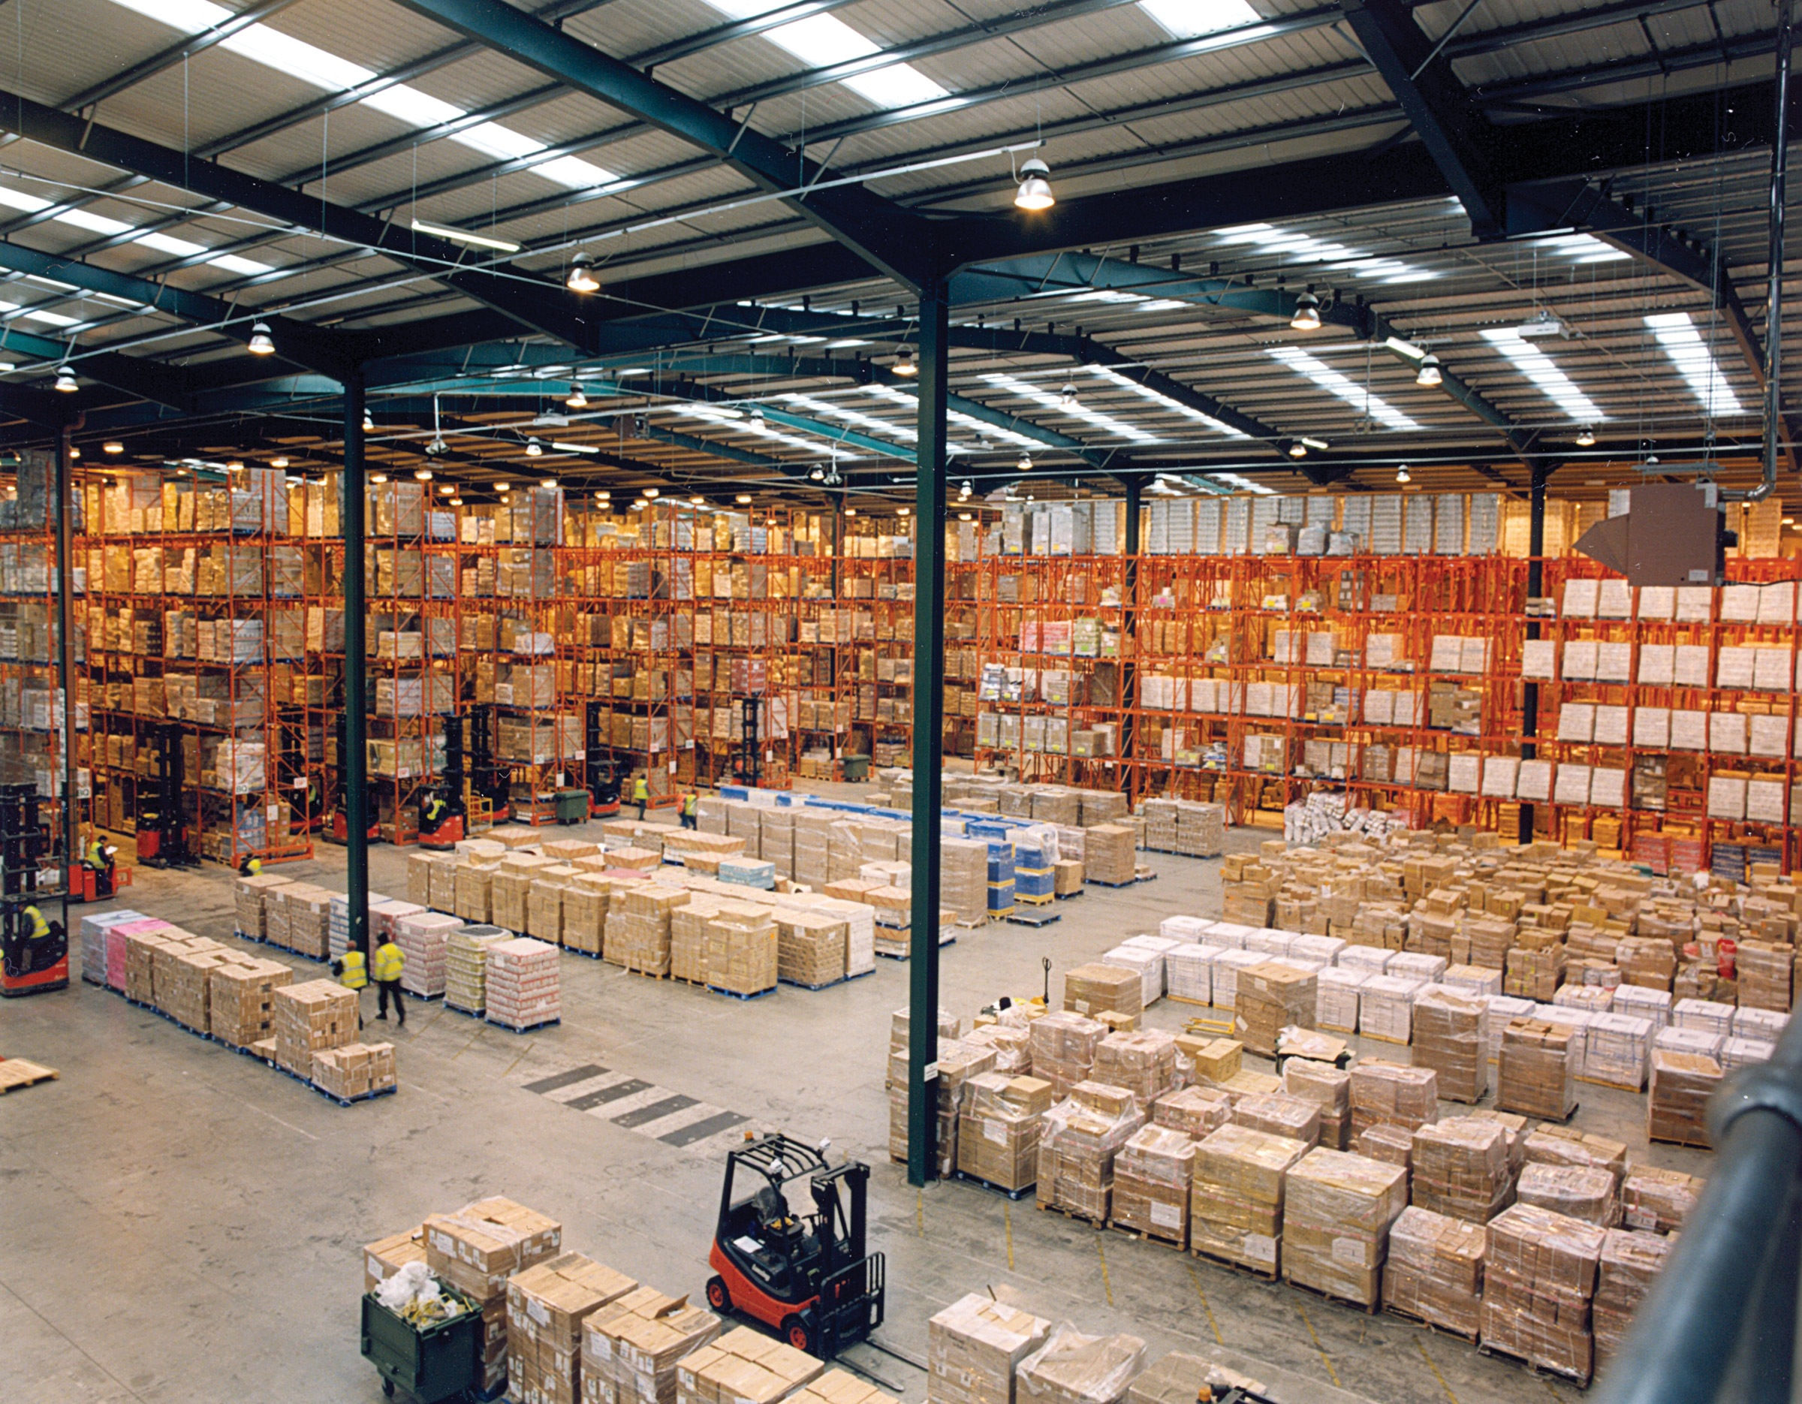
WITH SEPERATE PRESENTATION:

Slide 10
MODEL VIEW CONTROLLER
Separate presentation from logic of application
Model = Data/Logic
View = Presentation
Controller = Intermediary

Slide 11
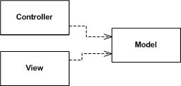
CLASSIC MVC
View Displays Data
Controller Processes Input
Both Observe Model for Changes
Smalltalk 80 — what’s that?

Slide 12
RAILS: SERVER SIDE MVC
Controller:
Fetches Model Data For View
Processes User Input
View:
Displays Page, Takes Raw User Input
Underlying Model:
Represents
App Logic
Insert Internet Here

Slide 13
ANGULAR: CLIENT SIDE MVC
Controller:
Defines Accessible Data in View
Processes User Input
View:
Displays User InterFace
Client Model: Thin Wrapper Around Server Calls
Two Way
Data
Binding!
Insert Internet Here
So many ways to do MVC…. MV*
Real Model:
On The Server

Slide 14
GO CHECK OUT THE CLASSICS
Martin Fowler - GUI Architectures - http://martinfowler.com/eaaDev/uiArchs.html
And a modern classic… Yehuda Katz - A Tale of Two MVCs - https://www.youtube.com/watch?v=s1dhXamEAKQ

